Slide 1

LOONA
Presentation

Slide 2



BOYCOTT BLOCKBERRY AIRLINES // BOARDING PASS
LOONAVERSE
LOONAVERSE
FLIGHT
DATE
NAME
OT12
01.DEC.2024
SHUBH
FLIGHT
DATE
OT12
01.DEC.2024
GATE
NAME
1
SHUBH
BOARDING PASS

Slide 3
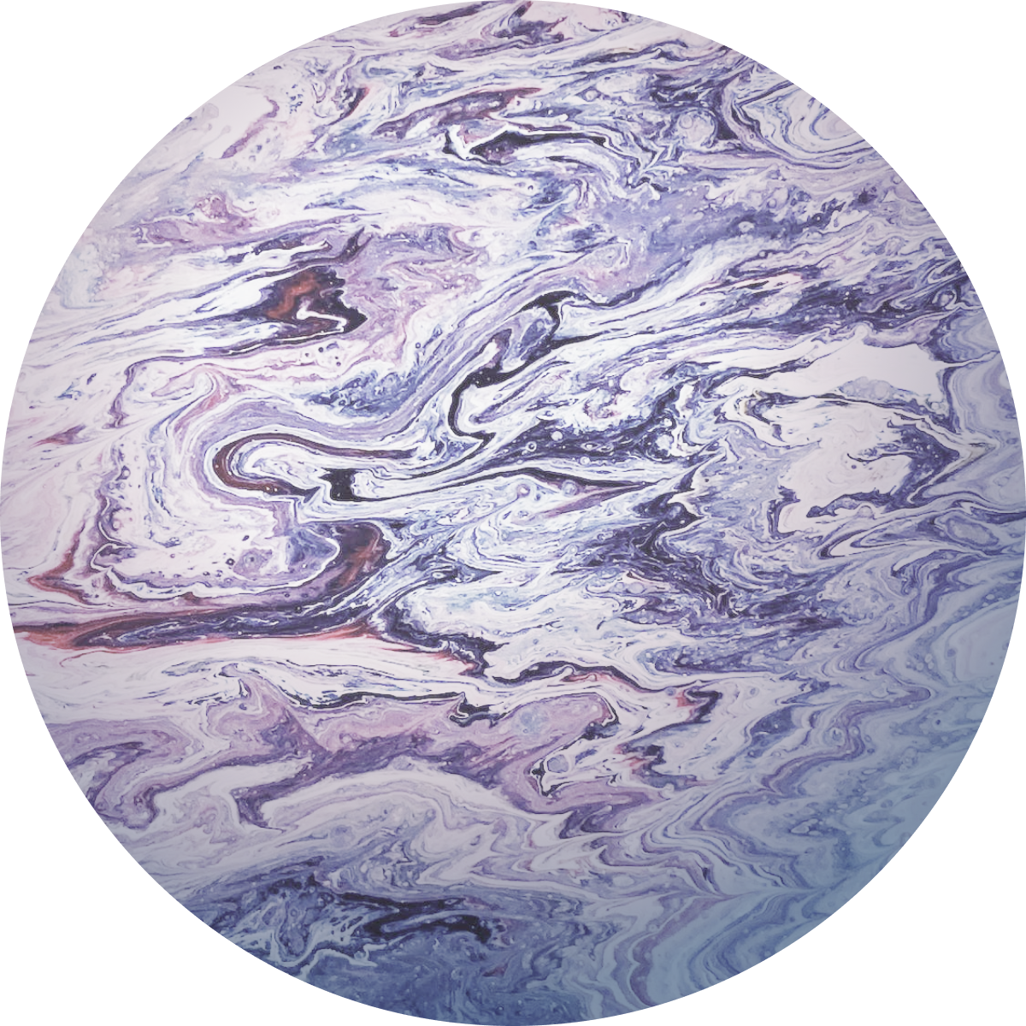
LOONAVERSE
BOYCOTT BLOCKBERRY AIRLINES // BOARDING PASS
FLIGHT
DATE
NAME
OT12
01.DEC.2024
SHUBH
LOONAVERSE
FLIGHT
DATE
OT12
01.DEC.2024
BOARDING PASS
GATE
NAME
1
SHUBH

Slide 4
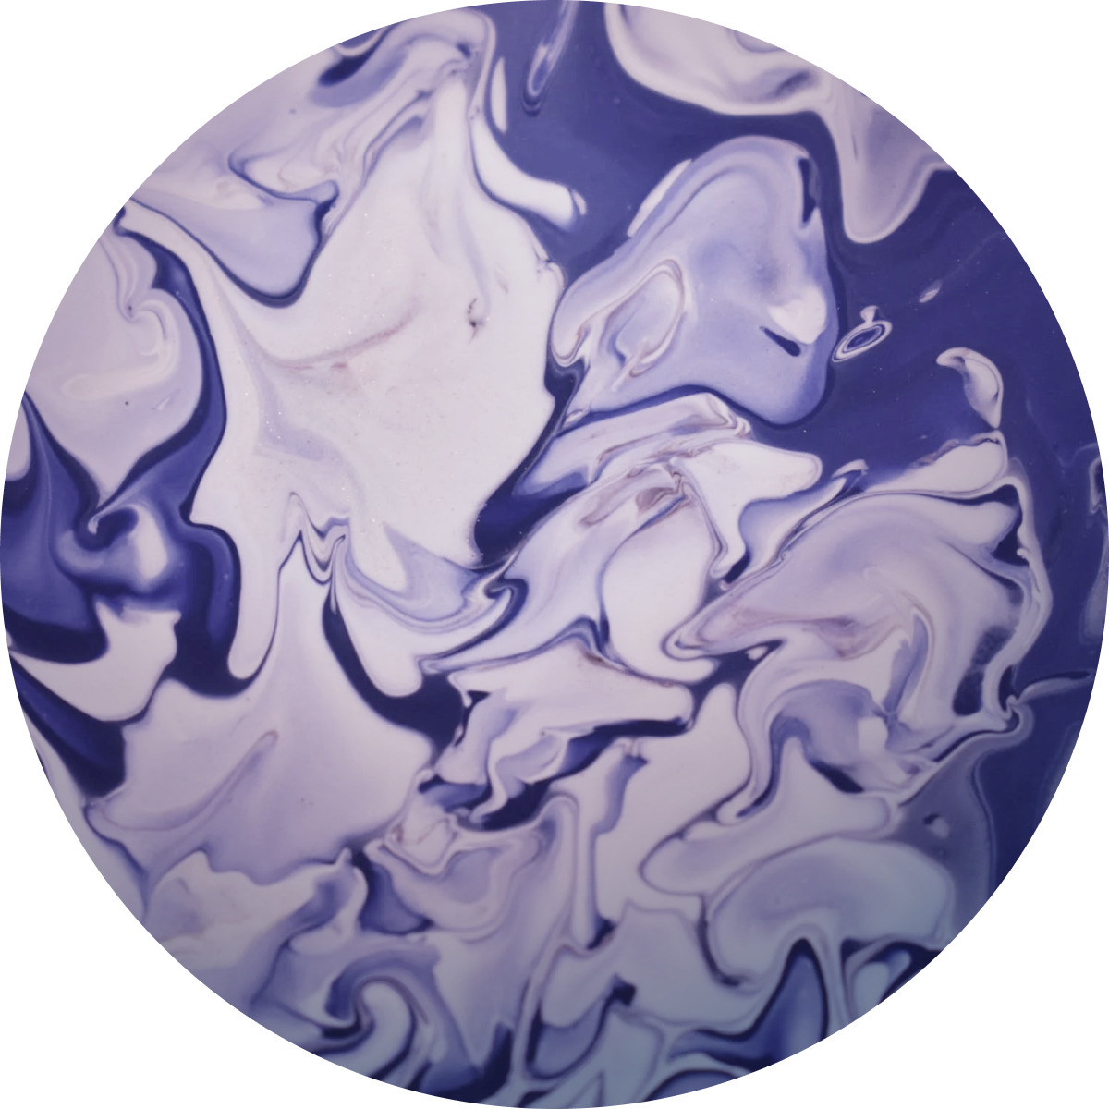
MOON
LOONAVERSE
FLIGHT
DATE
NAME
OT12
10.JAN.2023
@DSTORYCO
00
08
BOARDING PASS
The Earth’s only natural satellite.
DIAMETER
ROTATIONAL PERIOD
AXIAL TILT
3475km
655.7hrs
6.7°
BOYCOTT BLOCKBERRY AIRLINES // BOARDING PASS
LOONAVERSE
FLIGHT
DATE
OT12
10.JAN.2023
GATE
NAME
3
@DSTORYCO

Slide 5
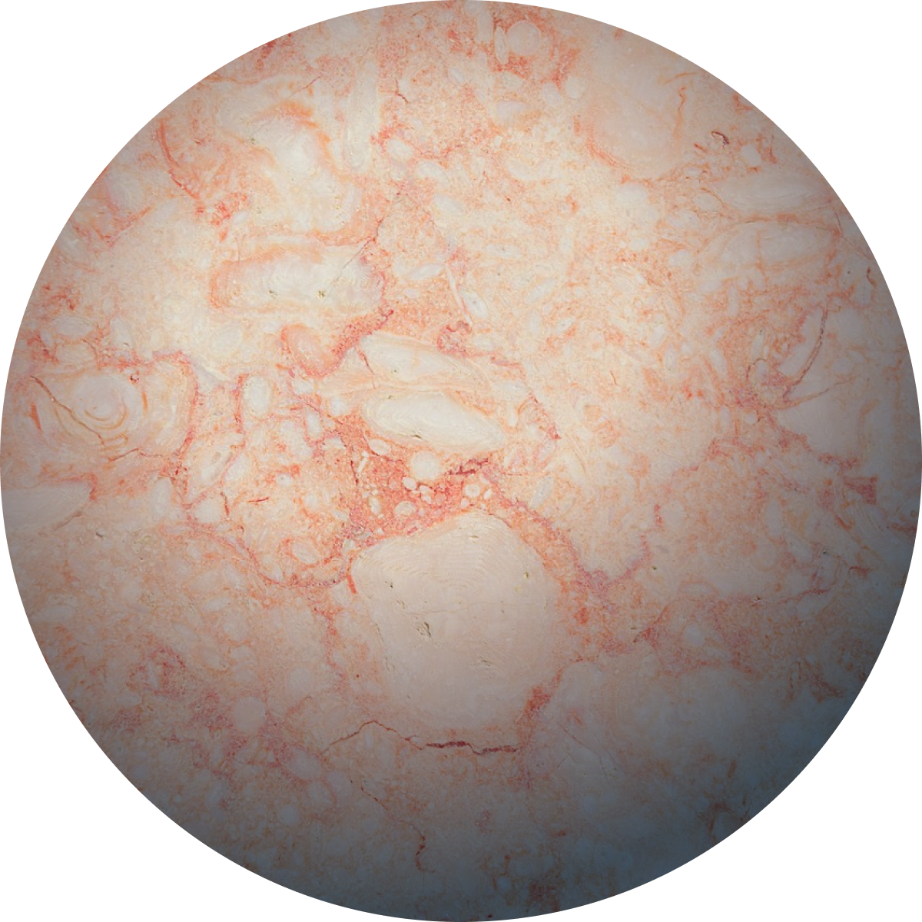
MERCURY
01
08
The smallest planet in our solar system and nearest to the Sun.
DIAMETER
ROTATIONAL PERIOD
AXIAL TILT
4879km
1407.6hrs
0.03°

Slide 6
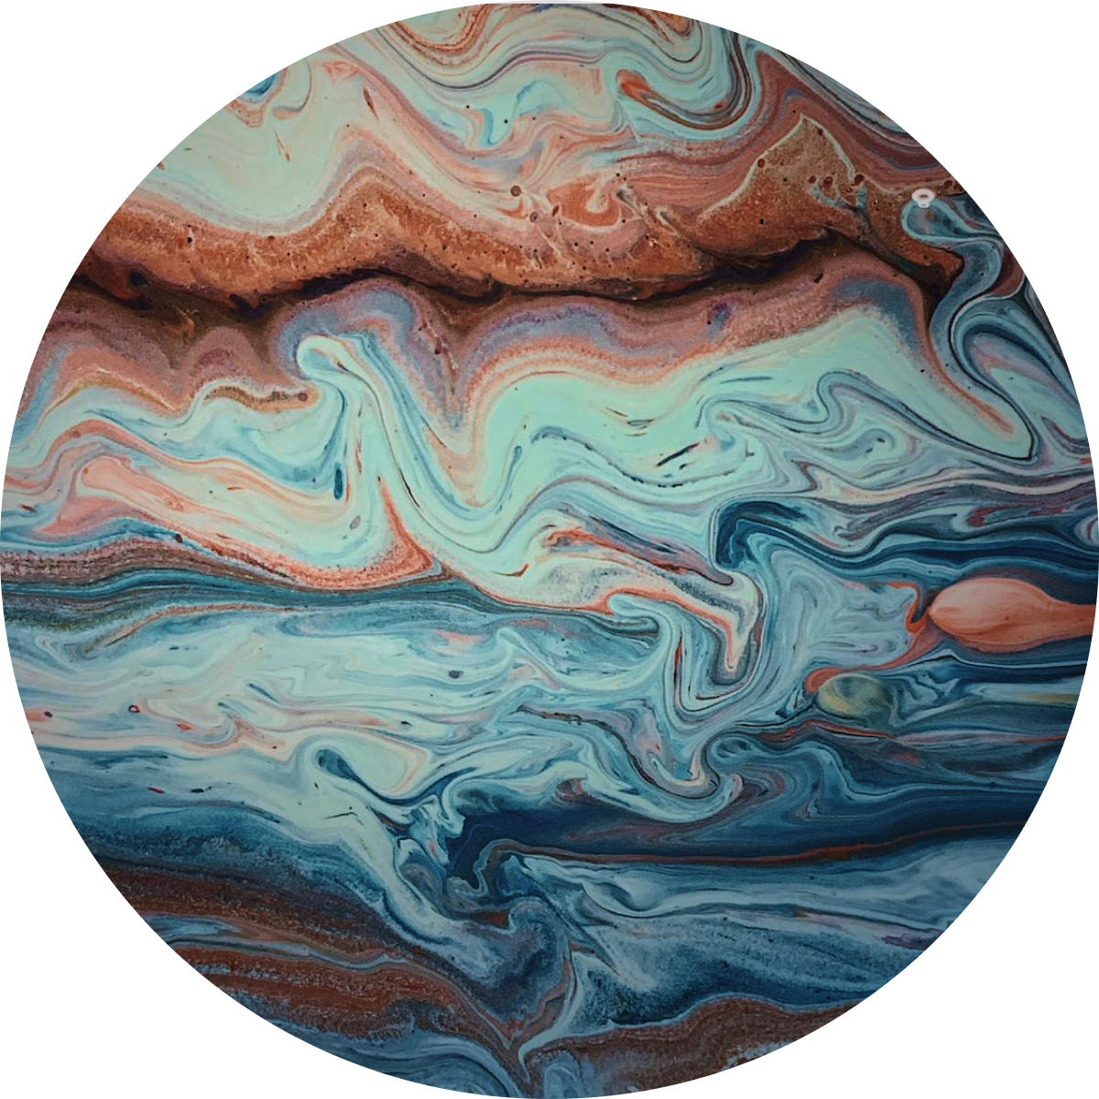
VENUS
02
08
Sometimes called Earth’s “sister” as it’s almost as large, with a similar composition.
DIAMETER
ROTATIONAL PERIOD
AXIAL TILT
12104km
-5832hrs
177.4°

Slide 7
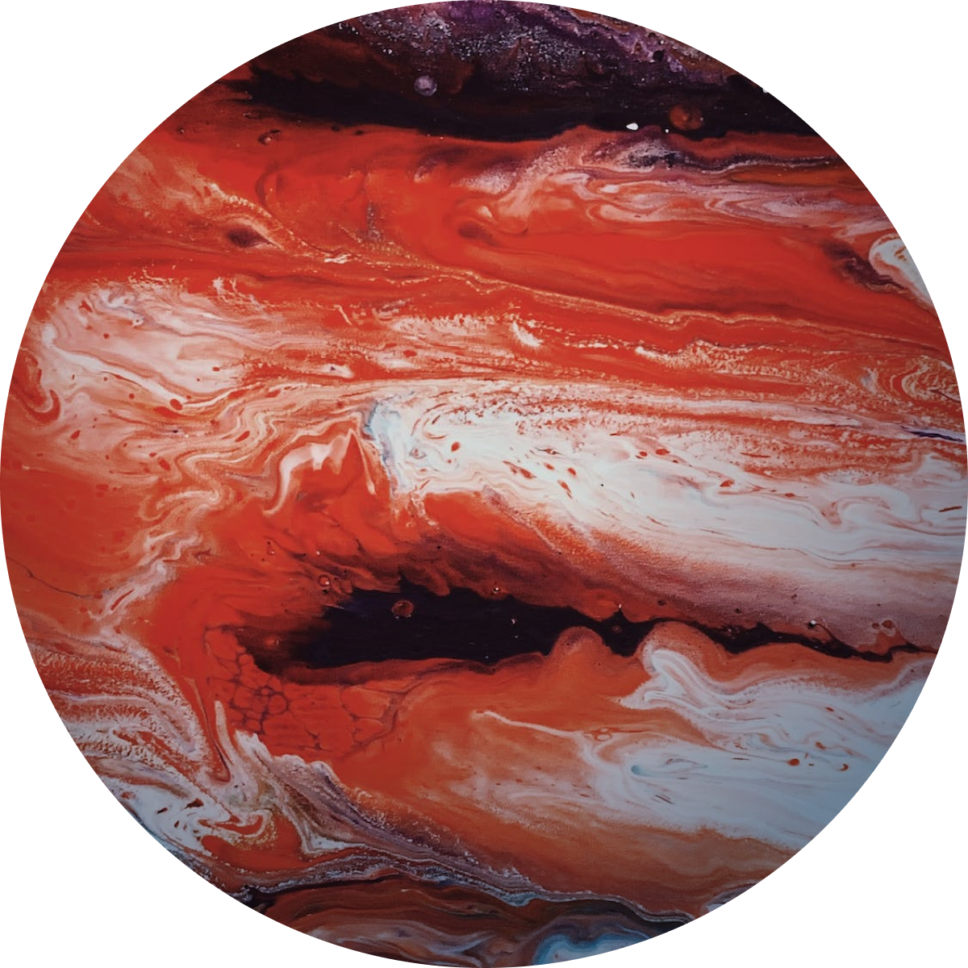
EARTH
03
08
The only place in the universe known to harbour life.
DIAMETER
ROTATIONAL PERIOD
AXIAL TILT
12756km
23.9hrs
23.5°

Slide 8
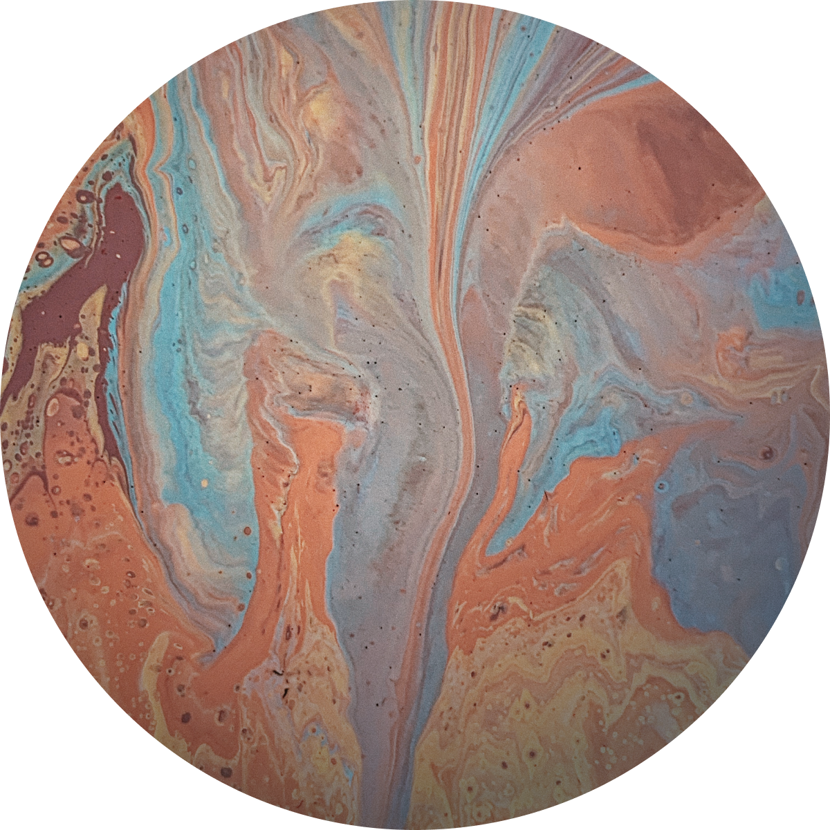
MARS
04
08
A terrestrial planet with a thin atmosphere, and has a crust composed of elements.
DIAMETER
ROTATIONAL PERIOD
AXIAL TILT
4879km
24.6hrs
25.2°

Slide 9
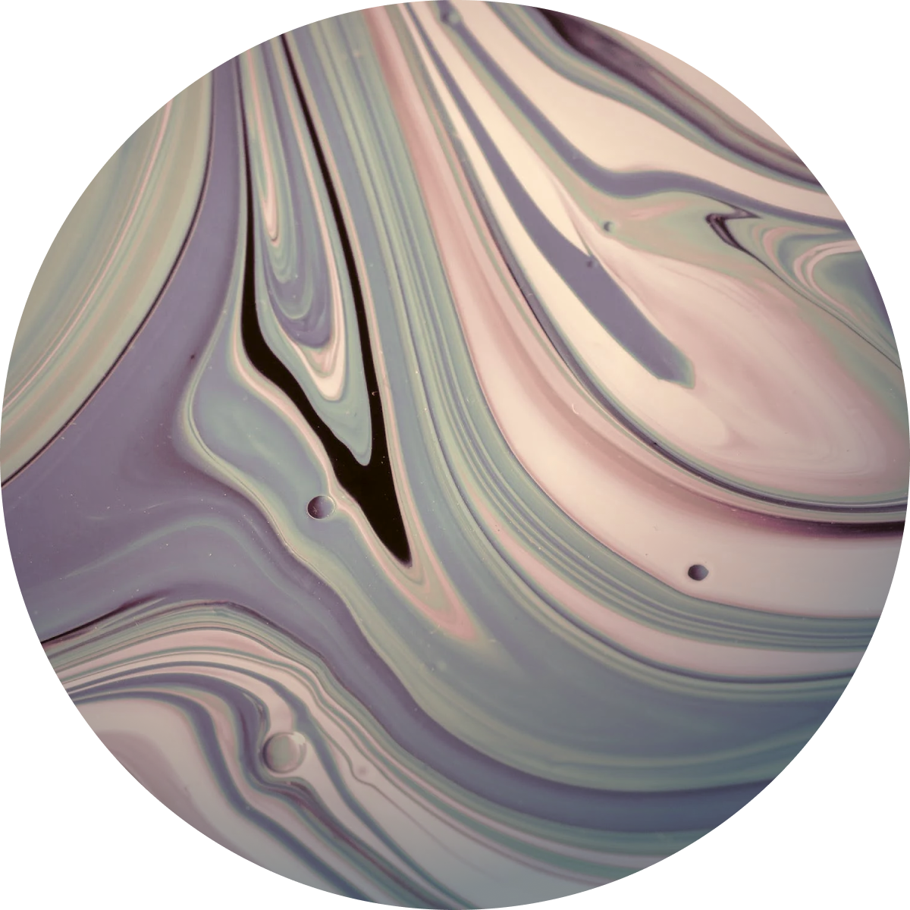
JUPITER
05
08
The largest planet in the Solar System.
DIAMETER
ROTATIONAL PERIOD
AXIAL TILT
140982km
9.9hrs
3.1°

Slide 10

SATURN
06
08
Only one-eighth the average density of Earth, but is over 95 times more massive.
DIAMETER
ROTATIONAL PERIOD
AXIAL TILT
120536km
10.7hrs
26.7°

Slide 11

URANUS
07
08
The coldest planetary atmosphere in the Solar System.
DIAMETER
ROTATIONAL PERIOD
AXIAL TILT
51118km
-17.2hrs
97.8°

Slide 12
NEPTUNE
08
08
Being composed primarily of gases an liquids, it has no well-defined solid surface.
DIAMETER
ROTATIONAL PERIOD
AXIAL TILT
49528km
16.1hrs
28.3°

